Slide 1
Faculty Senate Meeting
March 23, 2023

Slide 2
Meeting procedure
Only Senators may debate motions
Only Senators can vote
If you are not a Senator, or a proxy, you cannot vote or debate
Do not speak over someone, or out of order
Raise your hand to speak
The President may call on you and then you will have the floor
Unless you have been recognized (been told you have the floor), you may not speak

Slide 3
Meeting Minutes
We will be using Robert's Rules to guide our recording of minutes.
Robert's Rules of Order say that meeting minutes are simply a summary of what happened at the meeting.
They are not a play by play of everything that happened or what members said.
If needed, Faculty Senators may request access to the audio recording of the meeting. Please email facsenate@mst.edu with justification.

Slide 4
Agenda
Call to Order and Roll Call
D. Westenberg, Secretary

Slide 5
Agenda
Approval of Minutes
February 16, 2023

Slide 6
Agenda
III. President’s Report
K. Sheppard

Slide 7
Campus Matters:
Faculty Senate/Staff Council Climate Survey
Coming to an email near you on April 14, running through April 29
Important to take, despite COACHE and ADVANCE earlier
Staff not included in COACHE or ADVANCE
Our data moves faster than COACHE (once every three years)
ADVANCE was a specific type of input
Building longitudinal data for multi-year trends
Administration, Trustees, others are watching the trends

Slide 8
Campus Matters:
Faculty Senate/Staff Council Climate Survey
State of Survey
Same as last year, but we removed “what additional comments, positive or negative, do you have for administrators at Missouri S&T”
All other structured open-ended questions remain
Recommend that Library identify as staff
Added Kummer College
Changes approved by Personnel Committee

Slide 9
Graduate Student Bill of Rights Campus Meeting
Several campus leaders met in January to discuss
Priority Items from the Bill of Rights
Communication of Expectation and Fair Processes
Fair Work and Contract Expectations
Professional Development and Conduct
Questions? Concerns?

Slide 10
Test Optional Pilot Extension Proposal
March 2023

Slide 11
Proposal
MU, S&T, UMSL are requesting a 1-year extension of current policy
Originally enacted in 2020 due to COVID-19 pandemic
Extended in May 2022 for one additional year
Extension would allow for:
Comprehensive assessment of test optional student outcomes
Monitoring of rapidly shifting national trends around test optional
Extension would cover Fall 2024 recruitment cycle
UMKC became permanently test optional in 2020

Slide 12
Student Success
There is a strong correlation between high school core GPA and MU first-year GPA.
Data shows that both high school core GPA and ACT score have a positive correlation with MU first-year cumulative GPA
High school core GPA is the strongest indicator, accounting for 31.7% of the variance in first-year GPA. ACT scores account for 9.2% of the variance. When considered together, the prediction is slightly better, accounting for 33.5% of the variance in first-year GPA.

Slide 13
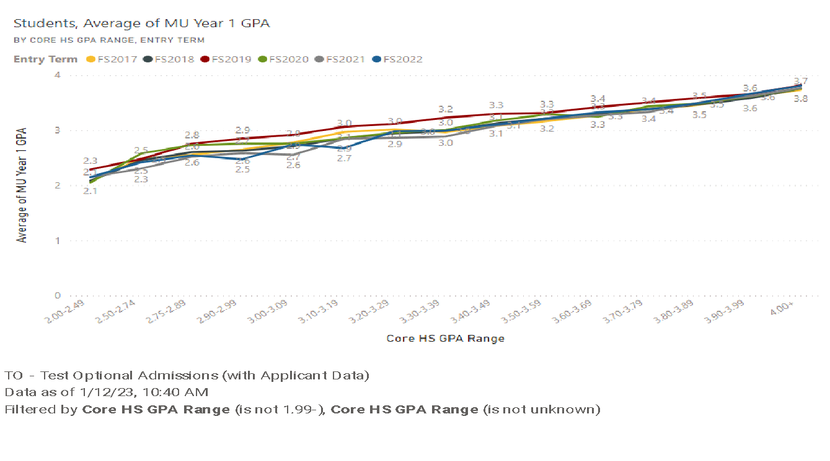
Student Success, cont’d

Slide 14
Missouri University of Science and Technology
David Spivey, Vice Provost for Enrollment Management

Slide 15
Competitive Landscape
Permanently test optional:
Colorado School of Mines
Illinois Institute of Technology
Worcester Polytechnic Institute
Have not announced decision:
New Mexico Institute of Mining and Technology
Rochester Institute of Technology
South Dakota School of Mines and Technology
University of Alabama in Huntsville
Continuing test optional pilot:
Michigan Institute of Technology
Stevens Institute of Technology

Slide 16
Admission to S&T
Fall 2021 and Fall 2022 First-Time College (FTC) US Applicants
Fall Term | Regular Application with Test Score | Application without Test Score
2021 | 3483 (75%) | 1140 (25%)
2022 | 3833 (76%) | 1200 (24%)

Slide 17
Admission to S&T, cont’d
Year 1 Data from Fall 2021 First-Time College (FTC) US Resident
 | Regular | Test Optional
Enrolled | 1000 | 168
Retained (1st Year) | 876 | 135
Retention Rate | 87.6% | 80.8%
Average Cumulative GPA | 3.33 | 3.18
% Academically Dismissed | 4.4% | 5.9%

Slide 18
Admission to S&T, cont’d
Admit Type Demographics, FTC US Resident – Enrolled Students
 | 2020 | 2021 |  |  | 2022
 | Regular | Regular | Test-Optional | Total | Regular | Test-Optional | Total
Pell Eligible | 261 (100%) | 197 (79%) | 53 (21%) | 250 (100%) | 221 (92%) | 18 (8%) | 239 (100%)
URM | 126 (100%) | 114 (79%) | 30 (21%) | 144 (100%) | 103 (88%) | 14 (12%) | 117 (100%)
In-State | 884 (100%) | 787 (86%) | 130 (14%) | 917 (100%) | 824 (96%) | 37 (4%) | 861 (100%)
Out-of-State | 208 (100%) | 213 (85%) | 38 (15%) | 251 (100%) | 237 (94%) | 15 (6%) | 252 (100%)

Slide 19
Campus Matters: Resolution
Extending Test Optional Admissions for One Year
We support a one-year extension for test-optional admissions at Missouri S&T, to be reviewed before the start of recruiting students for Fall 2025.

Slide 20
Campus Matters: Administrative Review

Slide 21
Campus Matters:
P&T Committee/Tenure Policy Committee
There is a discussion underway for some changes on the campus P&T committee, and anyone interested should contact their department's representative on the Tenure Policy Committee.

Slide 22
Campus Matters: Board of Curators Meeting
April 20
No agenda yet
They’ll discuss: Test optional and approve our By-Laws
Student/Curator Luncheon
We had over 40 students nominated to present and meet with Curators
We have chosen 8, with representation from all 3 colleges

Slide 23
Questions?

Slide 24
Agenda
IV. Campus Reports
A. Staff Council
M. Fowler

Slide 25
Agenda
IV. Campus Reports
B. Student Council
W. Retzlaff
(No report)

Slide 26
Agenda
IV. Campus Reports
C. Council of Graduate Students
M. Twarakavi
(No report)

Slide 27
Agenda
V. Special Topics Report
A. Administrative Reorganization C. Potts

Slide 28
Agenda
VI. Reports of Standing Committees
A. Campus Curricula P. DeWitt

Slide 29
Campus Curricula Committee Report
March 23, 2023
CCC Meeting - March 2, 2023
Total Committee Activity
4 Course Change Requests (CC Forms)
10 Program Change Forms (PC Forms)
6 Experimental Course Requests (EC Forms)

Slide 30
Campus Curricula Committee Report
March 23, 2023
Course Changes (CC) Requested
File: 4894 BIO SCI 5453 : Forest Insect Diversity & Ecology
File: 4929 EDUC 4410 : Behavior Management in Special Education
File: 2319.1 PSYCH 4994 : Psychology in Media
File: 4931 PSYCH 4995 : Rationality

Slide 31
Campus Curricula Committee Report
March 23, 2023
Program Changes (PC) Requested
File: 147.21 BIO SC-BS : Biological Sciences BS
File: 23.6 COGNEUR-MI : Cognitive Neuroscience Minor
File: 374.15 ENGL TC-BS : English & Technical Communication BS
File: 48.11 ENGL-BA : English BA
File: 363.5 HUMFACT-MI : Human Factors Psychology
File: 72.7 I/O PSY-MI : Indus/Organization Psych Minor
File: 192.47 PSYCH-BA : Psychology BA
File: 193.47 PSYCH-BS : Psychology BS
File: 243.10 PSYHLTH-MI : Psychology for Health Care - Minor
File: 132.9 TCH COM-BS : Technical Communication BS

Slide 32
Campus Curricula Committee Report
March 23, 2023
For Informational Purposes; No Senate Approval Required
Experimental Course (EC) Requested
File: 4923 BIO SCI 5001.008 : General Virology Lab
File: 4932 ENGLISH 1001.001 : Written English Communication Skills for International Students
File: 4933 ENGLISH 1001.002 : Oral English Communication for International Students
File: 4934 ENGLISH 5001.001 : Written English Communication Skills for International Graduate Students
File: 4935 ENGLISH 5001.002 : Oral English Communication for International Graduate Students
File: 4930 BIO SCI 5001.009 : Environmental Conservation

Slide 33
Campus Curricula Committee Report
March 23, 2023
Curriculum committee moves for FS to approve the 4 CC and 10 PC form actions.
Discussion: Questions or comments?

Slide 34
Agenda
VI. Reports of Standing Committees
B. CET D. Burns

Slide 35
Committee for
Effective Teaching
Presentation to Faculty Senate
March 23, 2023

Slide 36
SET Data
Response rates dropped from the previous semester
Still a little better than mid-pandemic
Could be student reaction to comment policy

Slide 37
Small drops in scores for old questions

Slide 38
New Behavioral Questions
Item | Spring '22 | Fall '22
Knowledgeable about Subject Matter | 3.64 | 3.65
Establishes Learning Objectives | 3.50 | 3.50
Uses Relevant Assessments | 3.47 | 3.47
Provides Constructive Feedback | 3.32 | 3.29
Accessible | 3.48 | 3.48
Attentive to Student Learning | 3.41 | 3.41
Engaging and Interesting | 3.32 | 3.30
Receptive to Feedback | 3.38 | 3.35
Respectful | 3.68 | 3.67
Almost no change!

Slide 39
Draft policy on hiding offensive comments
No one will ever make anyone hide comments!
It's an option for those who want it for qualifying comments:
Offensive comments with no constructive value
Faculty will have 2 week to review and flag comments before they are released to chairs (we will email!)
IT will send anonymized comments to a review panel made of the CET chair, the faculty ombudsperson, and the Chief Diversity Officer (or delegate)
The committee has a week to approve/reject
Chair thus see comments 3 weeks after release
You can still flag comments afterwards, they just won't be hidden from the chairs until after review

Slide 40
Training Supervisors and Students
Wolfe Retzlaff is emailing students with examples of constructive comments
COER will help promote providing useful feedback as a valuable job skill
Clair Kueny and Beth Kania-Gosche are going to talk to chairs about how best to use comments in faculty evaluations

Slide 41
Better SET data reporting
IT and Institutional Research are working on using PowerBI to create more flexible and valuable SET data reports for chairs, faculty, P&T dossiers, etc.
Options to aggregate across courses, years, etc.
Toggle between weighting by response #'s or not
Compare by NTT, faculty rank, etc.

Slide 42
Peer Observation
Five CET members observed each other using the instrument from Mizzou
We plan to bring a set of guidelines for peer observation to vote at the April Faculty Senate meeting

Slide 43
Self-Reflection
We are currently deciding on recommendations and guidelines for Self-reflection/teaching portfolios

Slide 44
Update from IT
 | Feature/Process | Status | Projected Timeline
1 | Access Control | Drafted/In testing | Production by Mid-March
2 | Updated reporting with Power BI | In progress/technical details defined | Planned implementation for Fall semester
3 | Comment Management: Hide Flag in data | In progress/technical details defined | Planned implementation by end of spring semester
4 | Comment Management: Hide Request Button | Not started | Over summer with production schedule (estimated)
5 | Comment Management: Automation of Request | Not started | By fall evaluation cycle
6 | Administrative Portal | In Progress | Planned implementation by end of spring semester
7 | Custom Access groups feature | In progress/technical details being defined | Implementation over summer/fall
8 | MOU | Terms being defined | Will be in place over summer

Slide 45
Statement on SET Anonymity from IT
The instructor evaluations are handled in a highly confidential manner but are not strictly anonymous. The user information can be accessed and viewed by the appropriate IT staff under specific circumstances. User information would only be released with significant legal involvement. Any request or subpoena would require discussion and involvement of general counsel to assess legal standard and requirements.

Slide 46
SET Instruction Text
Civility Statement: The faculty of Missouri S&T appreciates your feedback on the quality of instruction you receive here at the university. In order to best reflect your evaluations of our teaching, we request honest, professional, and civil responses.
This survey is intended to provide constructive feedback about teaching. The written comments and numeric responses will be visible to the instructor and their supervisors for evaluation purposes. Neither the instructor nor the supervisors can see which students submitted feedback.
This survey is not intended to voice complaints about instructors to supervisors; to do so, please contact the chair of the department directly.

Slide 47
Agenda
VI. Reports of Standing Committees
C. Personnel D. Westenberg

Slide 48
Referrals
Review Proposal to continue annual Faculty/Staff Climate Survey
Revise NTT Promotion Policy
Add representation from Kummer College
Review/revise composition of review committee
Who should chair the committee?
Addressing insufficient number or NTT Research Professors
Department representation on review committee (non-voting member)
Impact on independence of review

Slide 49
Agenda
VI. Reports of Standing Committees
D. ITCC K. Koob (for D. Stutts)

Slide 50
Update on Google Workspace for Education Plus
To Faculty Senate
March 23, 2023

Slide 51
Google is not going away!
Google is now expensive, and we are in year 2 of a 4 -year contract.
February 2023, There is a commitment of 3 CIOs of 4 UM System academic campus to continue to use Google after the end of the contract.
How much we use Google depends on work we are doing now.
Shared in the main campus GroupMe (~2800 members)

Slide 52
Work on securing the future of Google
Control the growth of storage.
Working to get an equitable cost apportionment.

Slide 53
Steps to control growth
UM Systems steps to control growth…
November 2022, individual drive storage quotas were set.
March 2023, shared drive storage quotas were set.
March 2023, prohibition on team drive creation without.
Future, change Canvas to save to OneDrive instead of Google.
S&T steps to control growth…
Clean up of decommissioned users.
Target excessive use under the Acceptable Usage Policy.

Slide 54
Agenda
VI. Reports of Standing Committees
E. Budgetary Affairs M. Fitch

Slide 55
Budgetary Affairs Committee
March 23, 2023
Referrals
None
Continuing referrals:
Current and next FY budget
Report on the “big picture balance sheet”

Slide 56
Budget timeline
Now: keep track of
state budget bills, department budget building, and
enrollment projections [A&R days = registered 4 Feb, 4 Mar, 1 Apr, 15 Apr, 9 Jun, 14 Aug], have vague guesstimate of budget changes
Mid-May: State budget signed, appropriation known, have fair guesstimate
Mid to late May: Enrollment (tuition) estimate set → budget values set
June: Salary guidelines released
Late June: Curators approve budget
July 1: start Fiscal Year
Sept 1: start salary year for academic employees

Slide 57
General Revenue Budget
 | FY 21 | FY 22 | FY 23 (budgeted)
Tuition and Fees | $119,477,148 | $119,255,572 | $123,885,664
Scholarship Allowance | (36,728,607) | (38,692,747) | (41,287,426)
Discount | 31% | 32% | 33%
Net Tuition & Fees | $83,748,541 | 80,562,825 | 82,598,238
State Appropriation | 45,690,941 | 53,026,096 | 55,942,347
Gift Revenues | 493,109 | 441,381 | 347,500
Recovery of F & A | 6,496,349 | 7,611,796 | 7,290,000
Endowment & Investment Income | 1,891,705 | 3,399,798 | 3,391,902
Sales & Services Income | 709,380 | 1,125,303 | 999,930
Other Incomes | 2,209,518 | 2,841,403 | 2,067,024
Revenue Contingency |  | - | -
Total Revenues | $140,239,544 | $149,008,602 | $152,636,941
Tuition variance:
- 1.6 MM UG
+ 1.9 MM Grad
- 1.1 MM distance
+ 1.2 MM contingency
+0.4 MM maybe (Spring melt)

Slide 58
Budget
Next year (FY 2024)
State appropriation
7% increase, maybe (Gov) = $3.9 MM
(We are not state employees in that way, don’t get excited)
Tuition:
Enrollment projection: optimistic about reaching target of 1,210 FTC (+6%) for fall 2023
Ahead on transfer students (up 48 transfer compared to this time last year)
Deposits about same; 940 on 13 March compared to 958 same date last year
One “melt” (forfeit deposit, not attend) compared to 20 same time last year
Tuition model change to tiers, designed as net zero change
But inflation may drive tuition increase

Slide 59
General Revenue Budget
 | FY 21 | FY 22 | FY 23 (budgeted) | FY 24 (vague dream)
Tuition and Fees | $119,477,148 | $119,255,572 | $123,885,664 | $123,529,412
Scholarship Allowance | (36,728,607) | (38,692,747) | (41,287,426) | (39,529,412)
Discount | 31% | 32% | 33% | 32%
Net Tuition & Fees | $83,748,541 | 80,562,825 | 82,598,238 | 84,000,000
State Appropriation | 45,690,941 | 53,026,096 | 55,942,347 | 59,858,861
Gift Revenues | 493,109 | 441,381 | 347,500 | 350,000
Recovery of F & A | 6,496,349 | 7,611,796 | 7,290,000 | 8,000,000
Endowment & Investment Income | 1,891,705 | 3,399,798 | 3,391,902 | 3,391,902
Sales & Services Income | 709,380 | 1,125,303 | 999,930 | 1,000,000
Other Incomes | 2,209,518 | 2,841,403 | 2,067,024 | 2,000,000
Revenue Contingency |  | - | - | -
Total Revenues | $140,239,544 | $149,008,602 | $152,636,941 | $158,600,763
Enrollment: -58 UG, +40 grad
I hope discount rate declining
7% increase
Blank = covers $1 MM tuition shortfall
+6 million w/o tuition increase

Slide 60
In order to meet the budget, it is needed to improve the yield from the current -1.88% deposited to +6%

Slide 61
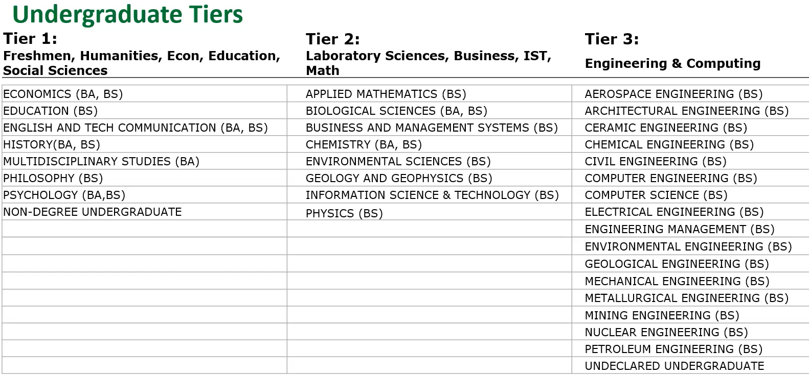
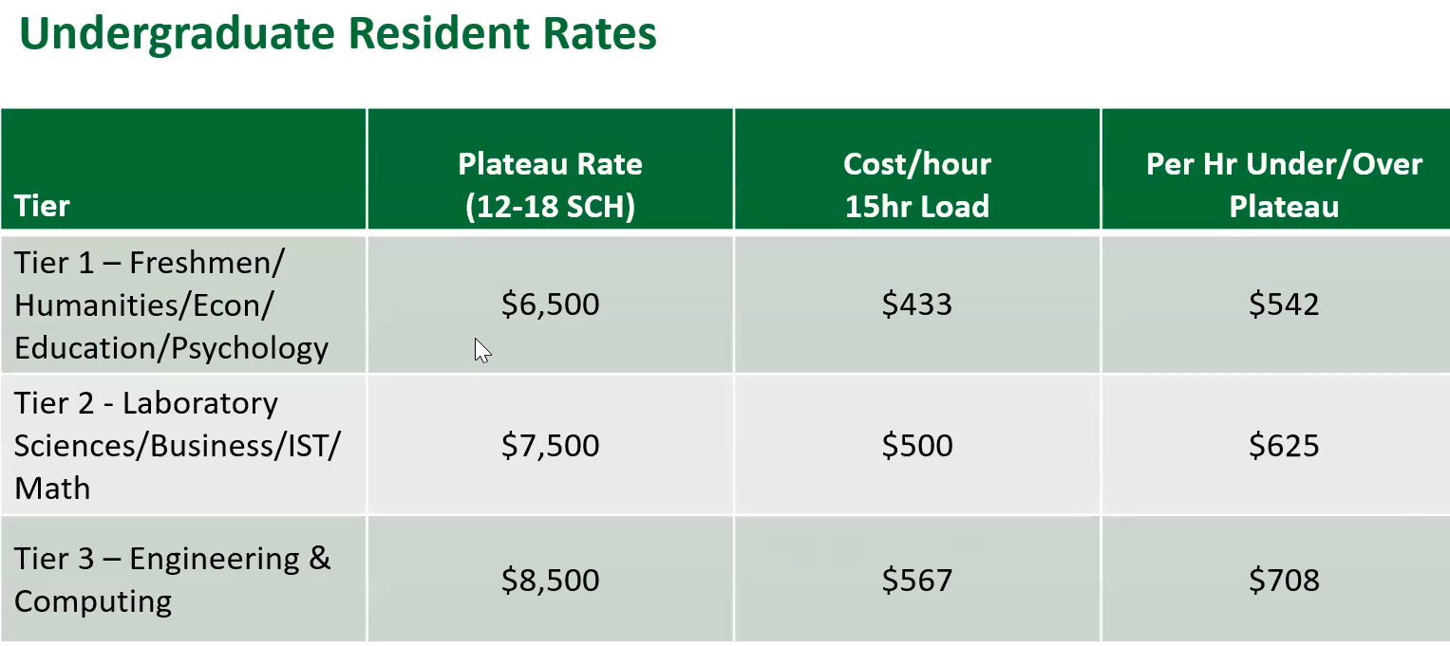
Tiered Tuition Model

Slide 62
Graduate Tuition
Program tiers will align with current course fees; no plateau
Considering a third grad student rate: non-resident domestic, lower than international student rate; drop prices, increase sales
Small number of current students, estimate plus six students to reach break-even

Slide 63
Tiered Tuition - Summer Term 2024
CFO suggests discounted summer rates and new asynchronous courses, drop prices = increase sales
No changes proposed to pay model for faculty teaching summer classes
Student tuition rate to be determined by admission status.
Tiered tuition model to apply to summer classes
If on-campus student, on-campus tuition rate for summer classes regardless of class mode
If distance, distance rate for summer classes regardless of class offering mode.

Slide 64
General Revenue Budget: costs
Total Revenues | $140,239,544 | $149,008,602 | $152,636,941 | $158,636,941
+$6 million why not?
Transfers | FY 21 | FY 22 (actual*) | FY 23 (budgeted) | FY 24 (hallucinated)
Internal | $1,988,391 | ($1,097,298) | $1,470,667 | $1,470,667
Mandatory Transfers | (3,483,219) | (3,285,882) | (3,376,171) | (3,376,171)
NonMandatory Transfers | (7,114,077) | (4,445,964) | (3,850,000) | (3,850,000)
Total Transfers | ($8,630,105) | ($8,829,144) | ($5,755,504) | ($5,755,504)
Expenditures
Salaries & Wages | $75,195,068 | $72,970,747 | $80,441,613 | $82,854,861
Benefit Expense | 24,209,899 | 23,542,539 | 27,358,459 | 28,179,212
Compensation | $99,404,966 | $96,513,286 | $107,800,003 | $111,034,074
Other Expenses | 32,471,617 | 35,350,345 | 39,049,616 | 41,847,363
Total Expenditures | $131,876,584 | $131,863,631 | $146,849,689 | $152,881,437
 |  | Increase | $14,986,058 | $6,031,748
[2022 Inflation 6.5%]
3% raise = budget net ~0
But: Enrollment Mgt ↑,
Annual Giving reincarnation.
…and new hires?
Guessed increases:
Maintenance +500k
Utilities +500k
Insurance, etc. +250k
Other +1550k

Slide 65
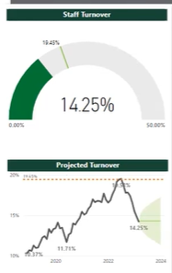
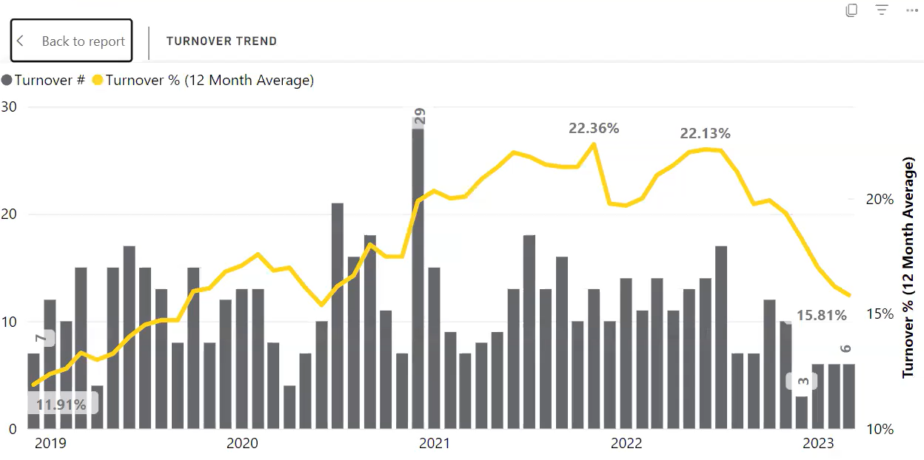
Staff
Turnover decrease: minimum pay increase, rewards for years of service, and professional development programs.
19.53% on 7/1/2022, 14.25% on 3/1/2023.

Slide 66
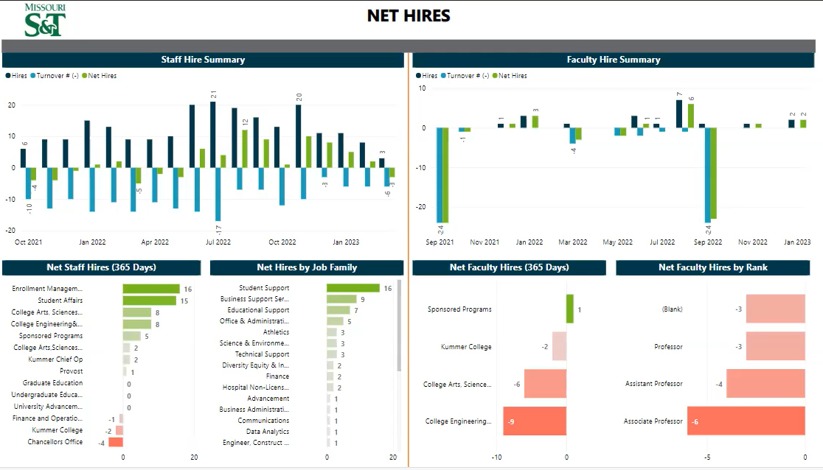
-20, AY 21-22
-21, AY 22-23, but…
… 26 open

